Slide 1
Chapter 24
Quality Management

Slide 2
Quality Management
Managing the quality of the software process and products

Slide 3
Objectives
To introduce the quality management process and key quality management activities
To explain the role of standards in quality management
To explain the concept of a software metric, predictor metrics and control metrics
To explain how measurement may be used in assessing software quality

Slide 4
Topics covered
Quality assurance and standards
Quality planning
Quality control
Software measurement and metrics

Slide 5
Software quality management
Concerned with ensuring that the required level of quality is achieved in a software product
Involves defining appropriate quality standards and procedures and ensuring that these are followed
Should aim to develop a ‘quality culture’ where quality is seen as everyone’s responsibility

Slide 6
What is quality?
Quality, simplistically, means that a product should meet its specification
This is problematical for software systems
  Tension between customer quality requirements (efficiency, reliability, etc.) and developer quality requirements (maintainability, reusability, etc.)
  Some quality requirements are difficult to specify in an unambiguous way
  Software specifications are usually incomplete and often inconsistent

Slide 7
The quality compromise
We cannot wait for specifications to improve before paying attention to quality management
Must put procedures into place to improve quality in spite of imperfect specification
Quality management is therefore not just concerned with reducing defects but also with other product qualities

Slide 8
Quality management activities
Quality assurance
  Establish organisational procedures and standards for quality
Quality planning
  Select applicable procedures and standards for a particular project and modify these as required
Quality control
  Ensure that procedures and standards are followed by the software development team
Quality management should be separate from project management to ensure independence

Slide 9
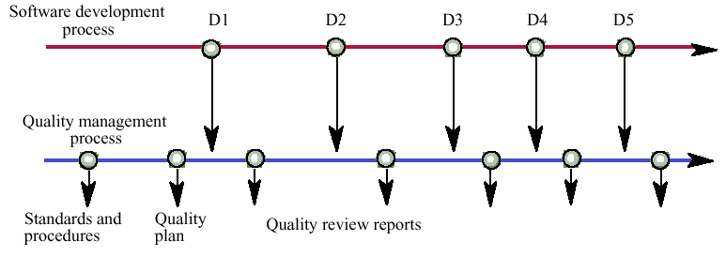
Quality management and software development

Slide 10
ISO 9000
International set ofstandards for quality management
Applicable to a range of organisations from manufacturing to service industries
ISO 9001 applicable to organisations which design, develop and maintain products
ISO 9001 is a generic model of the quality process Must be instantiated for each organisation

Slide 11
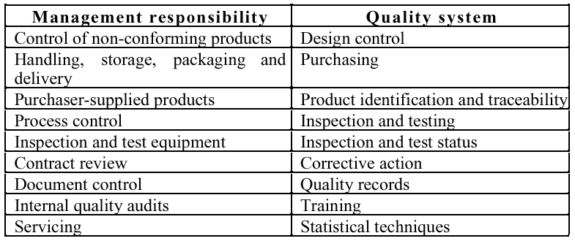
ISO 9001

Slide 12
ISO 9000 certification
Quality standards and procedures should be documented in an organisational quality manual
External body may certify that an organisation’s quality manual conforms to ISO 9000 standards
Customers are, increasingly, demanding that suppliers are ISO 9000 certified

Slide 13
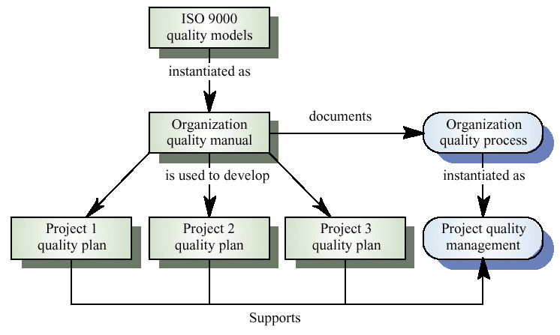
ISO 9000 and quality management

Slide 14
Quality assurance and standards
Standards are the key to effective quality management
They may be international, national, organizational or project standards
Product standards define characteristics that all components should exhibit e.g. a common programming style
Process standards define how the software process should be enacted

Slide 15
Importance of standards
Encapsulation of best practice- avoids
repetition of past mistakes
Framework for quality assurance process - it involves checking standard compliance
Provide continuity - new staff can understand
the organisation by understand the standards
applied

Slide 16
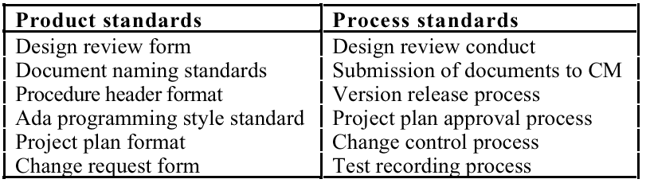
Product and process standards

Slide 17
Problems with standards
Not seen as relevant and up-to-date by software engineers
Involve too much bureaucratic form filling
Unsupported by software tools so tedious manual work is involved to maintain standards

Slide 18
Standards development
Involve practitioners in development. Engineers should understand the rationale underlying a standard
Review standards and their usage regularly.
Standards can quickly become outdated and this reduces their credibility amongst practitioners
Detailed standards should have associated tool
support. Excessive clerical work is the most
significant complaint against standards

Slide 19
Documentation standards
Particularly important - documents are the tangible manifestation of the software
Documentation process standards
  How documents should be developed, validated and maintained
Document standards
  Concerned with document contents, structure, and appearance
Document interchange standards
  How documents are stored and interchanged between different documentation systems

Slide 20
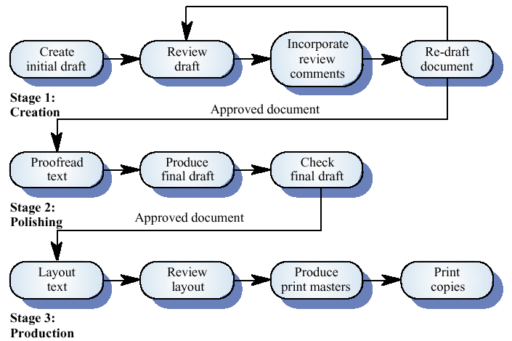
Documentation process

Slide 21
Document standards
Document identification standards
  How documents are uniquely identified
Document structure standards
  Standard structure for project documents
Document presentation standards
  Define fonts and styles, use of logos, etc.
Document update standards
  Define how changes from previous versions are reflected in a document

Slide 22
Document interchange standards
Documents are produced using different systems and on different computers
Interchange standards allow electronic documents to be exchanged, mailed, etc.
Need for archiving. The lifetime of word processing systems may be much less than the lifetime of the software being documented
XML is an emerging standard for document interchange which will be widely supported in future

Slide 23
Process and product quality
The quality of a developed product is influenced by the quality of the production process
Particularly important in software development as some product quality attributes are hard to assess
However, there is a very complex and poorly understood between software processes and product quality

Slide 24
Process-based quality
Straightforward link between process and product in manufactured goods
More complex for software because:
  The application of individual skills and experience is particularly imporant in software development
  External factors such as the novelty of an application or the need for an accelerated development schedule may impair product quality
Care must be taken not to impose inappropriate process standards

Slide 25
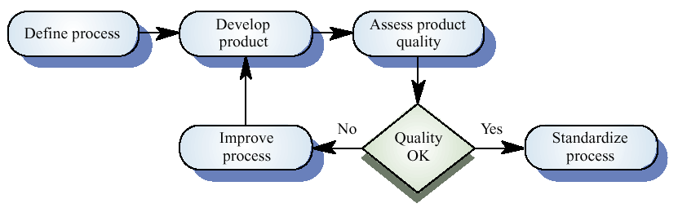
Process-based quality

Slide 26
Practical process quality
Define process standards such as how reviews
should be conducted, configuration
management, etc.
Monitor the development process to ensure
that standards are being followed
Report on the process to project management
and software procurer

Slide 27
Quality planning
A quality plan sets out the desired product qualities and how these are assessed ande define the most significant quality attributes
It should define the quality assessment process
It should set out which organisational standards should be applied and, if necessary, define new standards

Slide 28
Quality plan structure
Product introduction
Product plans
Process descriptions
Quality goals
Risks and risk management
Quality plans should be short, succinct documents
  If they are too long, no-one will read them

Slide 29
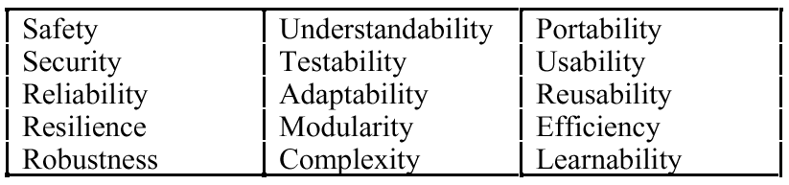
Software quality attributes

Slide 30
Quality control
Checking the software development process to ensure that procedures and standards are being followed
Two approaches to quality control
  Quality reviews
  Automated software assessment and software measurement

Slide 31
Quality reviews
The principal method of validating the quality of a process or of a product
Group examined part or all of a process or system and its documentation to find potential problems
There are different types of review with different objectives
  Inspections for defect removal (product)
  Reviews for progress assessment(product and process)
  Quality reviews (product and standards)

Slide 32
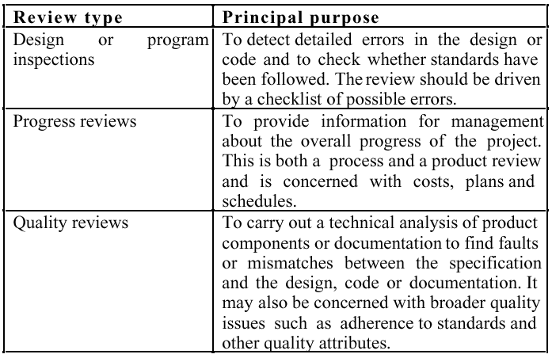
Types of review

Slide 33
Quality reviews
A group of people carefully examine part or all
of a software system and its associated
documentation.
Code, designs, specifications, test plans,
standards, etc. can all be reviewed.
Software or documents may be 'signed off' at a
review which signifies that progress to the next
development stage has been approved by
management.

Slide 34
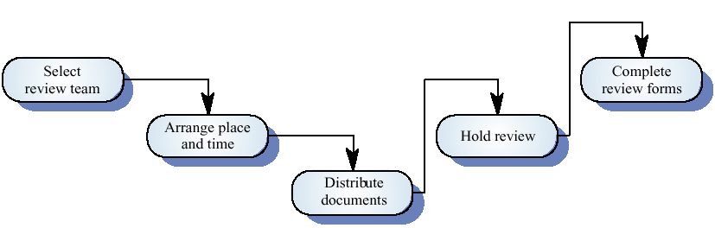
The review process

Slide 35
Review functions
Quality function - they are part of the general quality management process
Project management function - they provide information for project managers
Training and communication function - product knowledge is passed between development team members

Slide 36
Quality reviews
Objective is the discovery of system defects and inconsistencies
Any documents produced in the process may be reviewed
Review teams should be relatively small and reviews should be fairly short
Review should be recorded and records maintained

Slide 37
Review results
Comments made during the review should be
classified.
  No action. No change to the software or documentation is
  required.
  Refer for repair. Designer or programmer should correct an
  identified fault.
  Reconsider overall design. The problem identified in the
  review impacts other parts of the design. Some overall
  judgement must be made about the most cost-effective way
  of solving the problem.
Requirements and specification errors may
have to be referred to the client.

Slide 38
Software measurement and metrics
Software measurement is concerned with deriving a numeric value for an attribute of a software product or process
This allows for objective comparisons between techniques and processes
Although some companies have introduced measurment programmes, the systematic use of measurement is still uncommon
There are few standards in this area

Slide 39
Software metric
Any type of measurement which relates to a software system, process or related documentation
  Lines of code in a program, the Fog index, number of person-days required to develop a component
Allow the software and the software process to
be quantified
Measures of the software process or product
May be used to predict product attributes or to control the software process

Slide 40
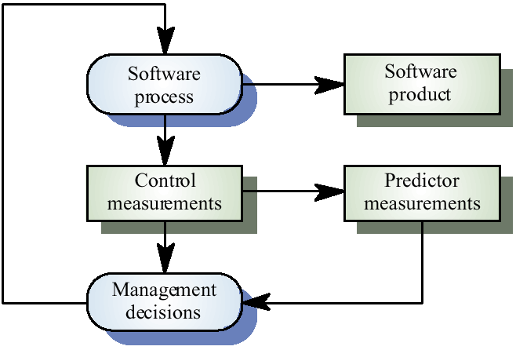
Predictor and control metrics

Slide 41
Metrics assumptions
A software property can be measured
The relationship exists between what we can
measure and what we want to know
This relationship has been formalized and
validated
It may be difficult to relate what can be measured to desirable quality attributes

Slide 42
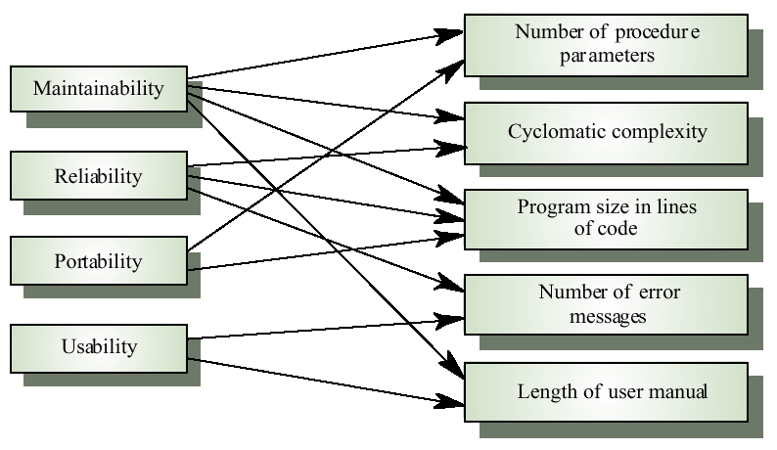
Internal and external attributes

Slide 43
The measurement process
A software measurement process may be part of a quality control process
Data collected during this process should be maintained as an organisational resource
Once a measurement database has been established, comparisons across projects become possible

Slide 44
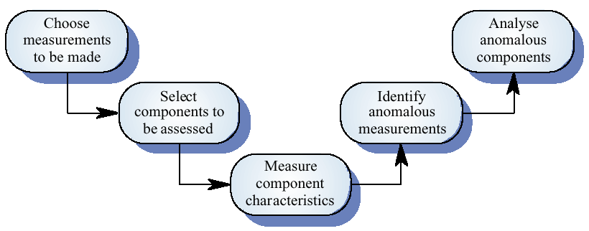
Product measurement process

Slide 45
Data collection
A metrics programme should be based on a set of product and process data
Data should be collected immediately (not in retrospect) and, if possible, automatically
Three types of automatic data collection
  Static product analysis
  Dynamic product analysis
  Process data collation

Slide 46
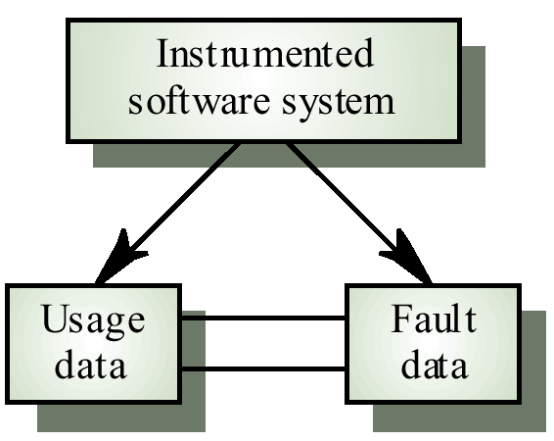
Automated data collection

Slide 47
Data accuracy
Don’t collect unnecessary data
  The questions to be answered should be decided in advance and the required data identified
Tell people why the data is being collected
  It should not be part of personnel evaluation
Don’t rely on memory
  Collect data when it is generated not after a project has finished

Slide 48
Product metrics
A quality metric should be a predictor of
product quality
Classes of product metric
  Dynamic metrics which are collected by measurements made of a program in execution
  Static metrics which are collected by measurements made of the system representations
  Dynamic metrics help assess efficiency and reliability; static metrics help assess complexity, understandability and maintainability

Slide 49
Dynamic and static metrics
Dynamic metrics are closely related to software quality attributes
  It is relatively easy to measure the response time of a system (performance attribute) or the number of failures (reliability attribute)
Static metrics have an indirect relationship with quality attributes
  You need to try and derive a relationship between these metrics and properties such as complexity, understandability and maintainability

Slide 50
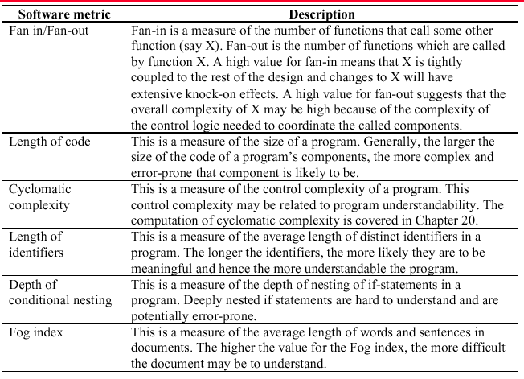
Software product metrics

Slide 51
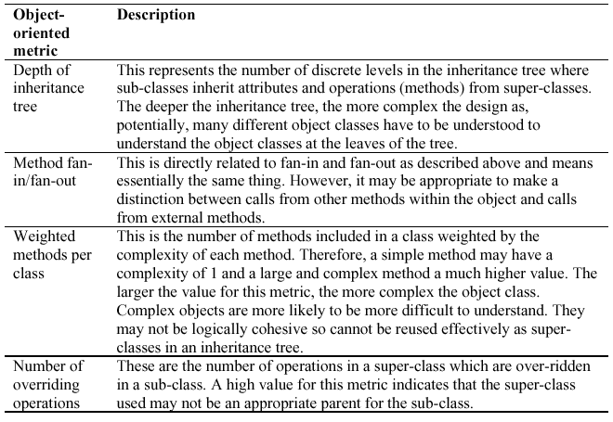
Object-oriented metrics

Slide 52
Measurement analysis
It is not always obvious what data means
  Analysing collected data is very difficult
Professional statisticians should be consulted if available
Data analysis must take local circumstances into account

Slide 53
Measurement surprises
Reducing the number of faults in a program leads to an increased number of help desk calls
  The program is now thought of as more reliable and so has a wider more diverse market. The percentage of users who call the help desk may have decreased but the total may increase
  A more reliable system is used in a different way from a system where users work around the faults. This leads to more help desk calls

Slide 54
Key points
Software quality management is concerned with ensuring that software meets its required standards
Quality assurance procedures should be documented in an organisational quality manual
Software standards are an encapsulation of best practice
Reviews are the most widely used approach for assessing software quality

Slide 55
Key points
Software measurement gathers information about both the software process and the software product
Product quality metrics should be used to identify potentially problematical components
There are no standardised and universally applicable software metrics

